Slide 1
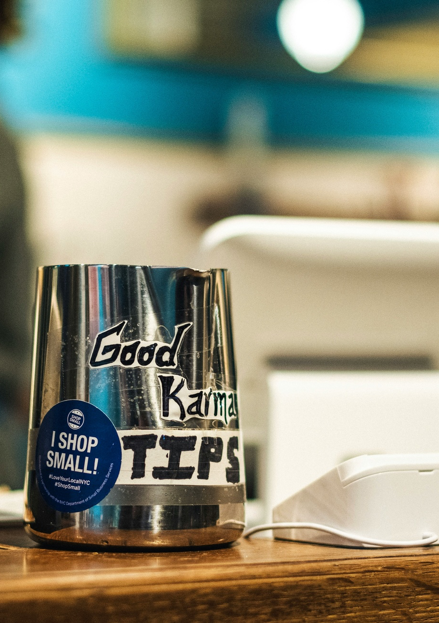
Glitch.AI - Tipping with RevenueCat
An introduction to building a robust tipping system for Glitch AI using the Virtual Currency feature of RevenueCat.

Slide 2




Scenario Overview
Viewers can purchase a subscription
Continuous token delivery
Robust token tracking
Integrate with Glitch tipping system
Tokens should continue to be deposited as long as the subscription is active, even if the user stops opening the app
The system for tracking tokens should be robust and maintain an accurate balance even through momentary outages
Subscription will automatically deposit Glitch tokens into their account every month
The logic for actually tipping the content creators will be handled by Glitch, as they already have this system in place
Addressing these key requirements, the RevenueCat virtual currency integration will power Glitch AI's subscription-based tipping system, providing a seamless and reliable experience for content creators and viewers.

Slide 3
Glitch Token Virtual Currency
Virtual Currency
1. Create your Glitch Tokens
Virtual Currency is a new RevenueCat feature supporting a token and tipping economy that is a perfect fit for Glitch tokens.
Define your Glitch Tokens in your Product Catalog
Set a token name
Set a product identifier
Pick an icon to quickly identify your token
2. Assign to a Product
3. Assign to a Subscription
Set the number of tokens to grant
Optionally Offer tokens when starting a trial
RevenueCat's Customer Info API and redundant webhook system ensure reliable token balance tracking and delivery

Slide 4

Subscriptions
When a Glitch customer purchases a subscription
RevenueCat creates a new customer record.
This record is associated with the viewer's Glitch account.
This establishes the subscription lifecycle for the customer.

Slide 5


Initial Token Deposit
RevenueCat automatically deposits Glitch Tokens into the customer's balance upon subscription purchase.
The number of tokens associated with the subscription is determined in the Product Catalog during token setup.

Slide 6

Recurring Token Deposits
Powered by the RevenueCat subscription engine, your customers will never run out of tokens.
RevenueCat will automatically deposit Glitch Tokens into the customer's balance each month as long as the customer's subscription remains active.
This applies even if the customer stops using the Glitch app.

Slide 7
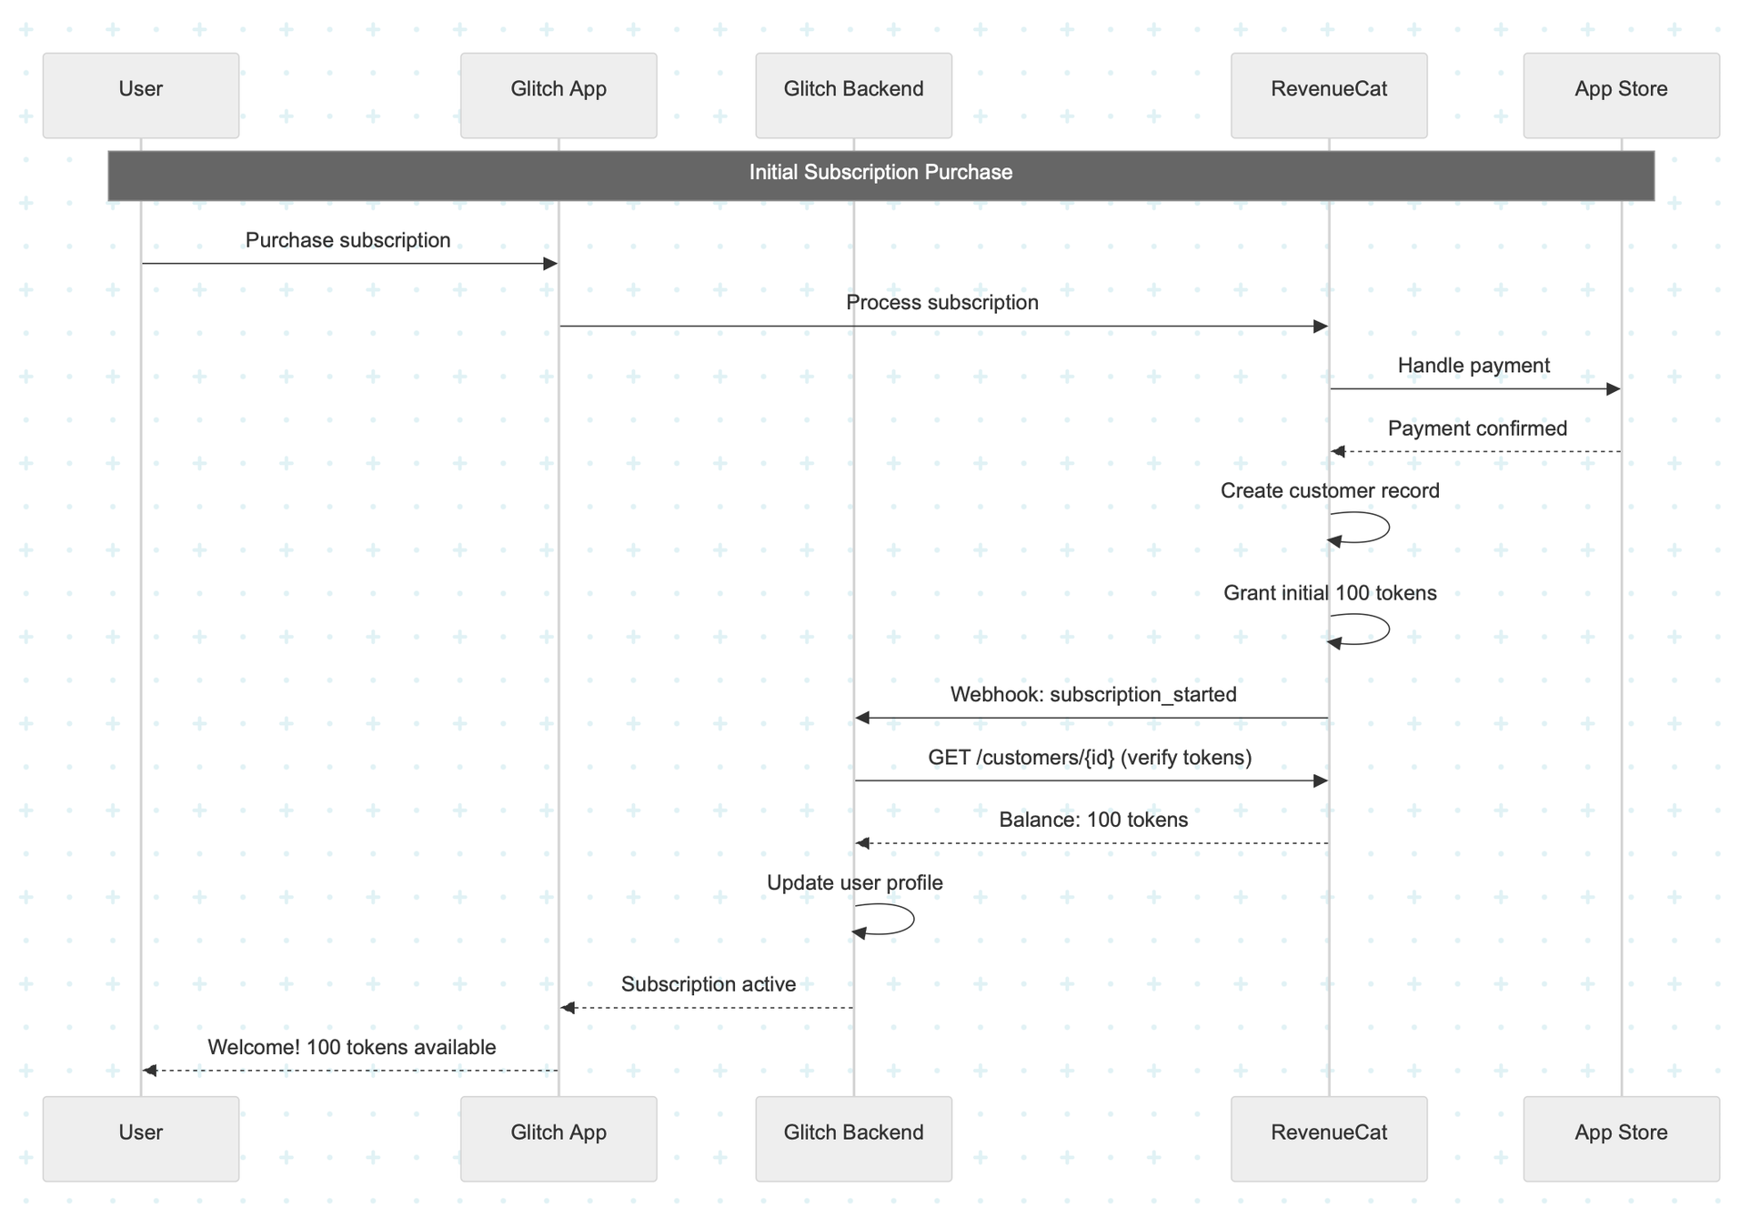
New Subscription Integration

Slide 8

Integration with Glitch Tipping System
RevenueCat virtual currency seamlessly integrates with Glitch's existing tipping infrastructure.
This integration allows Glitch Tokens purchased by subscribers to be easily used for tipping content creators.
Glitch can leverage RevenueCat's Developer API to securely deposit or spend Glitch Tokens on behalf of their customers
This ensures token balances are maintained accurately and any token-related transactions are properly reflected in Glitch's tipping system.

Slide 9
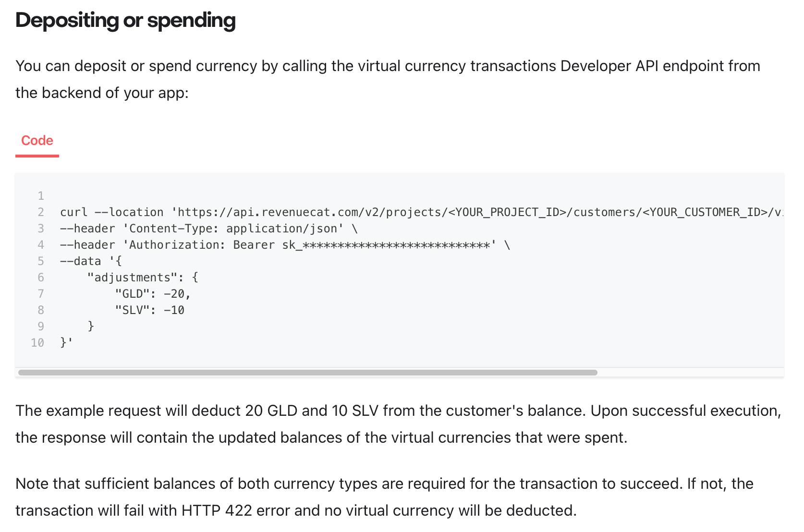
Reliable Token Balance Tracking
Developer API
Deposit Glitch Tokens for each user
Spend Glitch Tokens for each user
Retrieve Glitch Token balance for each user
Ensure accuracy and up-to-date information

Slide 10

Q & A
RevenueCat is a leading platform for in-app purchases and subscriptions. Our Virtual Currency feature is currently in beta. As an early adopter your input and requirements will help shape the future development of virtual currencies to best suit your needs.

